Slide 1
Jeopardy (BOYD STYLE)
AHSGE
Review Edition

Slide 2
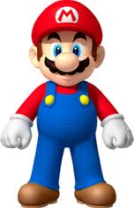
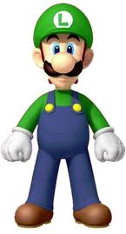
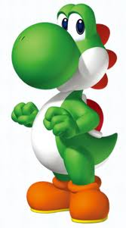
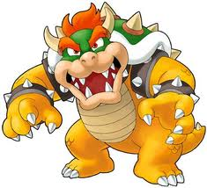
O
Y
!
B
D
100 Points
100 Points
100 Points
100 Points
100 Points
200 Points
200 Points
200 Points
200 Points
200 Points
300 Points
300 Points
300 Points
300 Points
300 Points
400 Points
400 Points
400 Points
400 Points
400 Points
500 Points
500 Points
500 Points
500 Points
500 Points

Slide 3
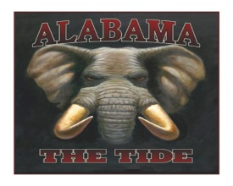
True or False
The Warren Commission concluded that Kennedy's assassin acted alone.
TRUE

Slide 4
Kennedy’s legislative agenda was called the _____.
NEW FRONTIER

Slide 5
During the space race, Kennedy’s goal for the nation was to be the first to _____.
PUT A MAN ON
THE MOON

Slide 6
The Alliance for Progress was _____.
A SERIES OF COOPERATIVE
AID PROJECTS WITH LATIN AMERICA

Slide 7
DAILY DOUBLE
Johnson’s Republican opponent in the 1964 presidential election was _____.
BARRY GOLDWATER

Slide 8
Kennedy’s “flexible response” plan called for _____.
BUILDUP OF
CONVENTIONAL TROOPS

Slide 9
One of the programs created under Lyndon Johnson's Great Society was ____, which financed health care for welfare recipients.
MEDICAID

Slide 10
DAILY DOUBLE
The way in which states draw up political districts based on changes in population is called ____.
REAPPORTIONMENT

Slide 11
Lyndon Johnson's Project ____ funded a preschool program for the disadvantaged.
HEAD START

Slide 12
True or False
The Bay of Pigs action successfully pressured the Soviets into removing their missiles from Cuba.
FALSE

Slide 13
John Kennedy became the first United States president who followed the ____ religion.
CATHOLIC

Slide 14
The belief that the Soviet Union had more nuclear weapons than the United States was known as the _____.
MISSILE GAP

Slide 15
The nightclub owner who killed Kennedy’s assassin was _____.
JACK RUBY

Slide 16
In July 1969, Kennedy’s dream of having the United States be the first to put a man on the moon came true when _____ stepped foot on the moon.
NEIL ARMSTRONG

Slide 17
In Germany, the visible symbol of the Cold War division between East and West was the _____.
BERLIN WALL

Slide 18
On April 17, 1961, armed Cuban exiles landed on the south coast of Cuba at _____.
BAY OF PIGS

Slide 19
The secretly trained Cuban exiles were known as the _____.
LA BRIGADA

Slide 20
President Johnson’s program to find young people jobs which became essentially a domestic Peace Corps was known as _____.
VISTA

Slide 21
Daily Double
President Kennedy was assassinated in the city of ____, and on what day month and year.
DALLAS: NOVEMBER 22ND 1963

Slide 22
True or False
Lyndon Johnson was the first president to broadcast his press conferences live on television.
FALSE

Slide 23
The Fourteenth Amendment requires
DUE PROCESS

Slide 24
True or False
The Peace Corps is still active today.
TRUE

